Slide 1
Nuclear Fuel Performance
NE 533: Spring 2025

Slide 2
Last Time
All reactors have basic requirements they must meet
Typically, the “fuel system” is thought to consist of the fuel itself, the gap, the cladding, and the coolant
Mining -> Processing -> Conversion -> Enrichment -> Powder -> Compaction/Sintering -> Rod/Assembly
U₃O₈ must be converted to UF₆ for enrichment, which is then converted to UO₂ powder for pellet manufacture
UO₂ microstructure from fabrication strongly impacts fuel performance

Slide 3
heat Generation

Slide 4
Calculating heat generation rate for a given fuel
We know about 200 MeV of energy is available due to a fission (210 MeV minus neutrinos)
We know the fission cross section of the target nuclide (tabulated)
We know the neutron flux (given by reactor conditions)
We can calculate the fission atom density
The heat generation rate, Q is given by:
Q = E_{f} x N_{f} x σ_{f} x φ
Where E_{f} is the fission energy, N_{f} is the fission atom density, σ_{f} is the fission cross section, and φ is the neutron flux
Units: J/fission x atoms/cm³ x (fission/neutron)*(cm²/atom) x (neutron/cm²-s) = J/cm³-s = W/cm³

Slide 5
Calculating heat generation rate for a given fuel
Cross sections:
ENDF database: Nuclear Data Sheets 148 (2018) 1–142
Thermal neutron (E=0.025 eV) U235 fission cross section: ~586.8 barns
1 barn = 10⁻²⁴ cm²
Fission atom density
Atom density of U-235 = UO2 density x 1/molar mass x Avogadro's number x atom fraction x enrichment

Slide 6
Example

Slide 7
heat transport

Slide 8
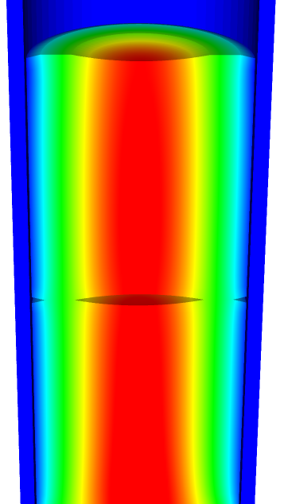
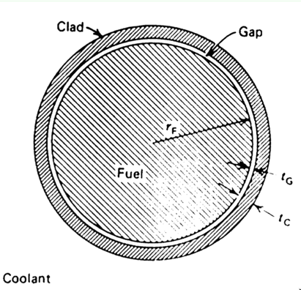
Heat transport route
Heat is produced in the fuel, transports through the cladding and gap, and into the coolant
Important quantities include
Volumetric heat generation rate Q (W/cm³)
Fuel Centerline temperature T₀
Surface temperature of the fuel T_{S}
Inner cladding temperature T_{IC}
Outer cladding temperature T_{OC}
Coolant temperature T_{cool}
Fuel pellet radius r_{F}
Gap thickness t_{G}
Cladding thickness t_{c}
Coolant heat transfer h_{c}

Slide 9
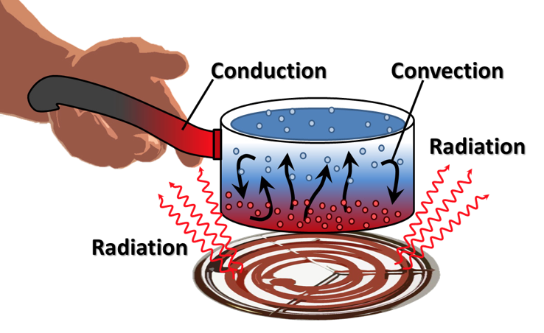
Heat can be transported in three ways
Convection
Heat transfer through mass movement of liquid or gas
Radiation
Heat transfer by means of photons in electromagnetic waves
Conduction
Heat transfer by molecular, phonon, and electronic vibration/collisions

Slide 10
Heat transfer mode in fuel systems?
How is heat transported through the fuel?
Conduction
How is the heat transported through the gap?
Mostly conduction, some convection
How is heat transported through the cladding?
Conduction
How is heat transported to the coolant?
Convection

Slide 11
Heat conduction equation
ρ is the density, c_{p} is the specific heat, T is the temperature, t is the time, and k is the thermal conductivity, Q is heat generation
It is a partial differential equation in time and space of the temperature, T(x, t), where x is a vector defining the position in space
What do we need to know to solve this equation?
The geometry of our problem
The initial condition of T
The boundary conditions of T
Is each parameter is a function of T
If they aren’t a function of T, do they vary in space and time for some other reason?

Slide 12
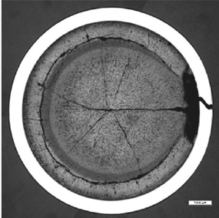
What is our geometry for the problem?
Reactor geometry depends on reactor type
The idealized geometry of each fuel rod is axisymmetric, but in reality, it is 3D
Fuel pellet defects cause 3D geometry
The stacked pellets may not be stacked perfectly, causing their center axis to not be aligned, also causing 3D geometry

Slide 13
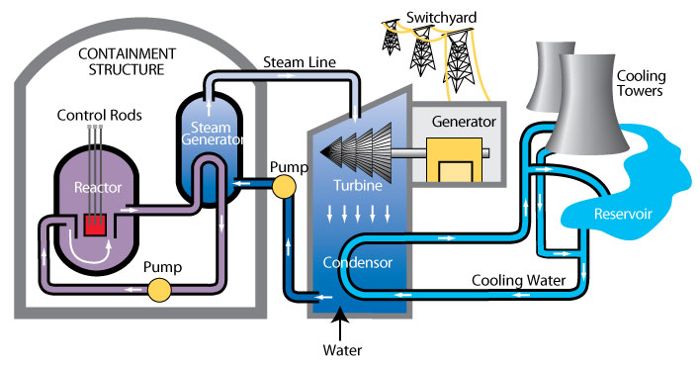
The initial condition of T
The initial condition of T is set by the state of the reactor directly before startup (or before time of interest)
The initial temperature is uniform throughout the fuel, equal to the initial coolant temperature
T(x, 0) = T_{cool}(0)

Slide 14
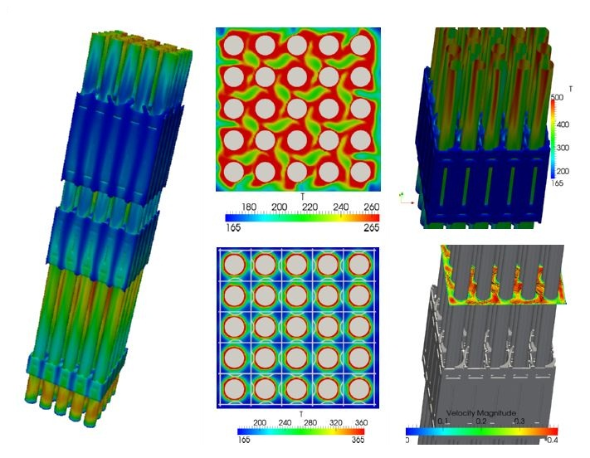
Boundary conditions?
The boundary conditions on T is set by the coolant flow
The temperature of the coolant T_{cool} is complicated
It varies along the length of the fuel rod (axially)
It various around the circumference of the fuel rod

Slide 15
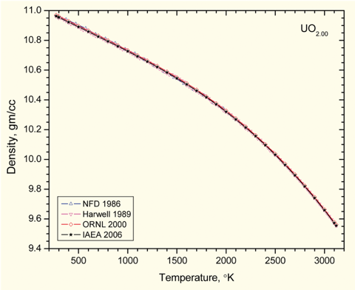
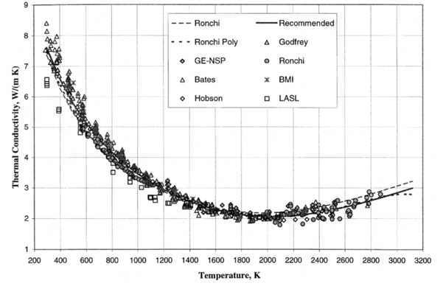
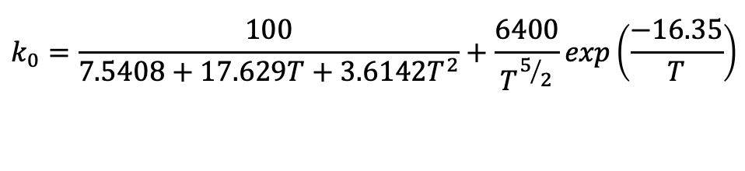
Fuel properties
All properties vary as a function of composition, thus as a function of burnup/time
Density varies as a function of T (thermal expansion)
Thermal conductivity also varies with temperature
$$k_{0}=\frac{100}{7.5408+17.629T+3.6142T^{2}}+\frac{6400}{T^{5/2}}exp\left(\frac{−16.35}{T}\right)$$

Slide 16
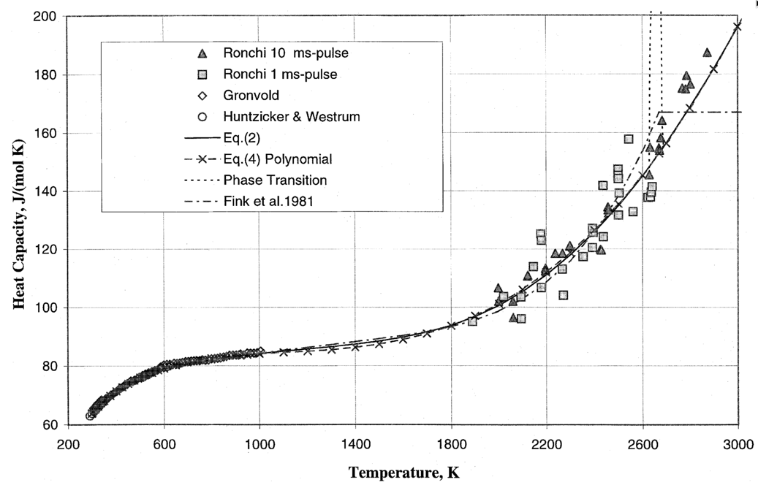
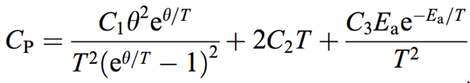
The heat capacity is a function of temperature
θ = 548.68 K
C₁ = 302.27 J/kg-K
C₂ = 8.463 × 10⁻³ J/kg-K²
C₃ = 8.741 × 10⁷ J/kg
E_{a} = 18531.7 K
ORNL/TM-2000/351

Slide 17
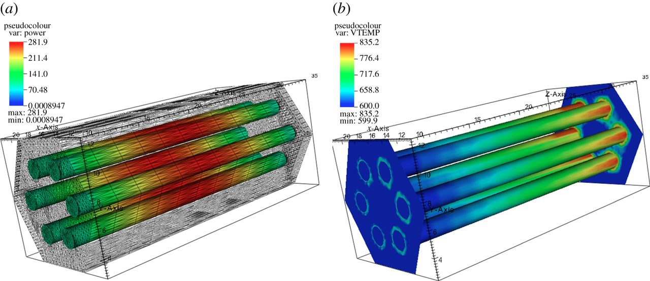
The heat generation rate is a function of the thermal neutron flux, which varies in time and space
Q = E_{f} N_{f} σ_{f} ϕ_{th}

Slide 18
Analytical solve of heat conduction

Slide 19
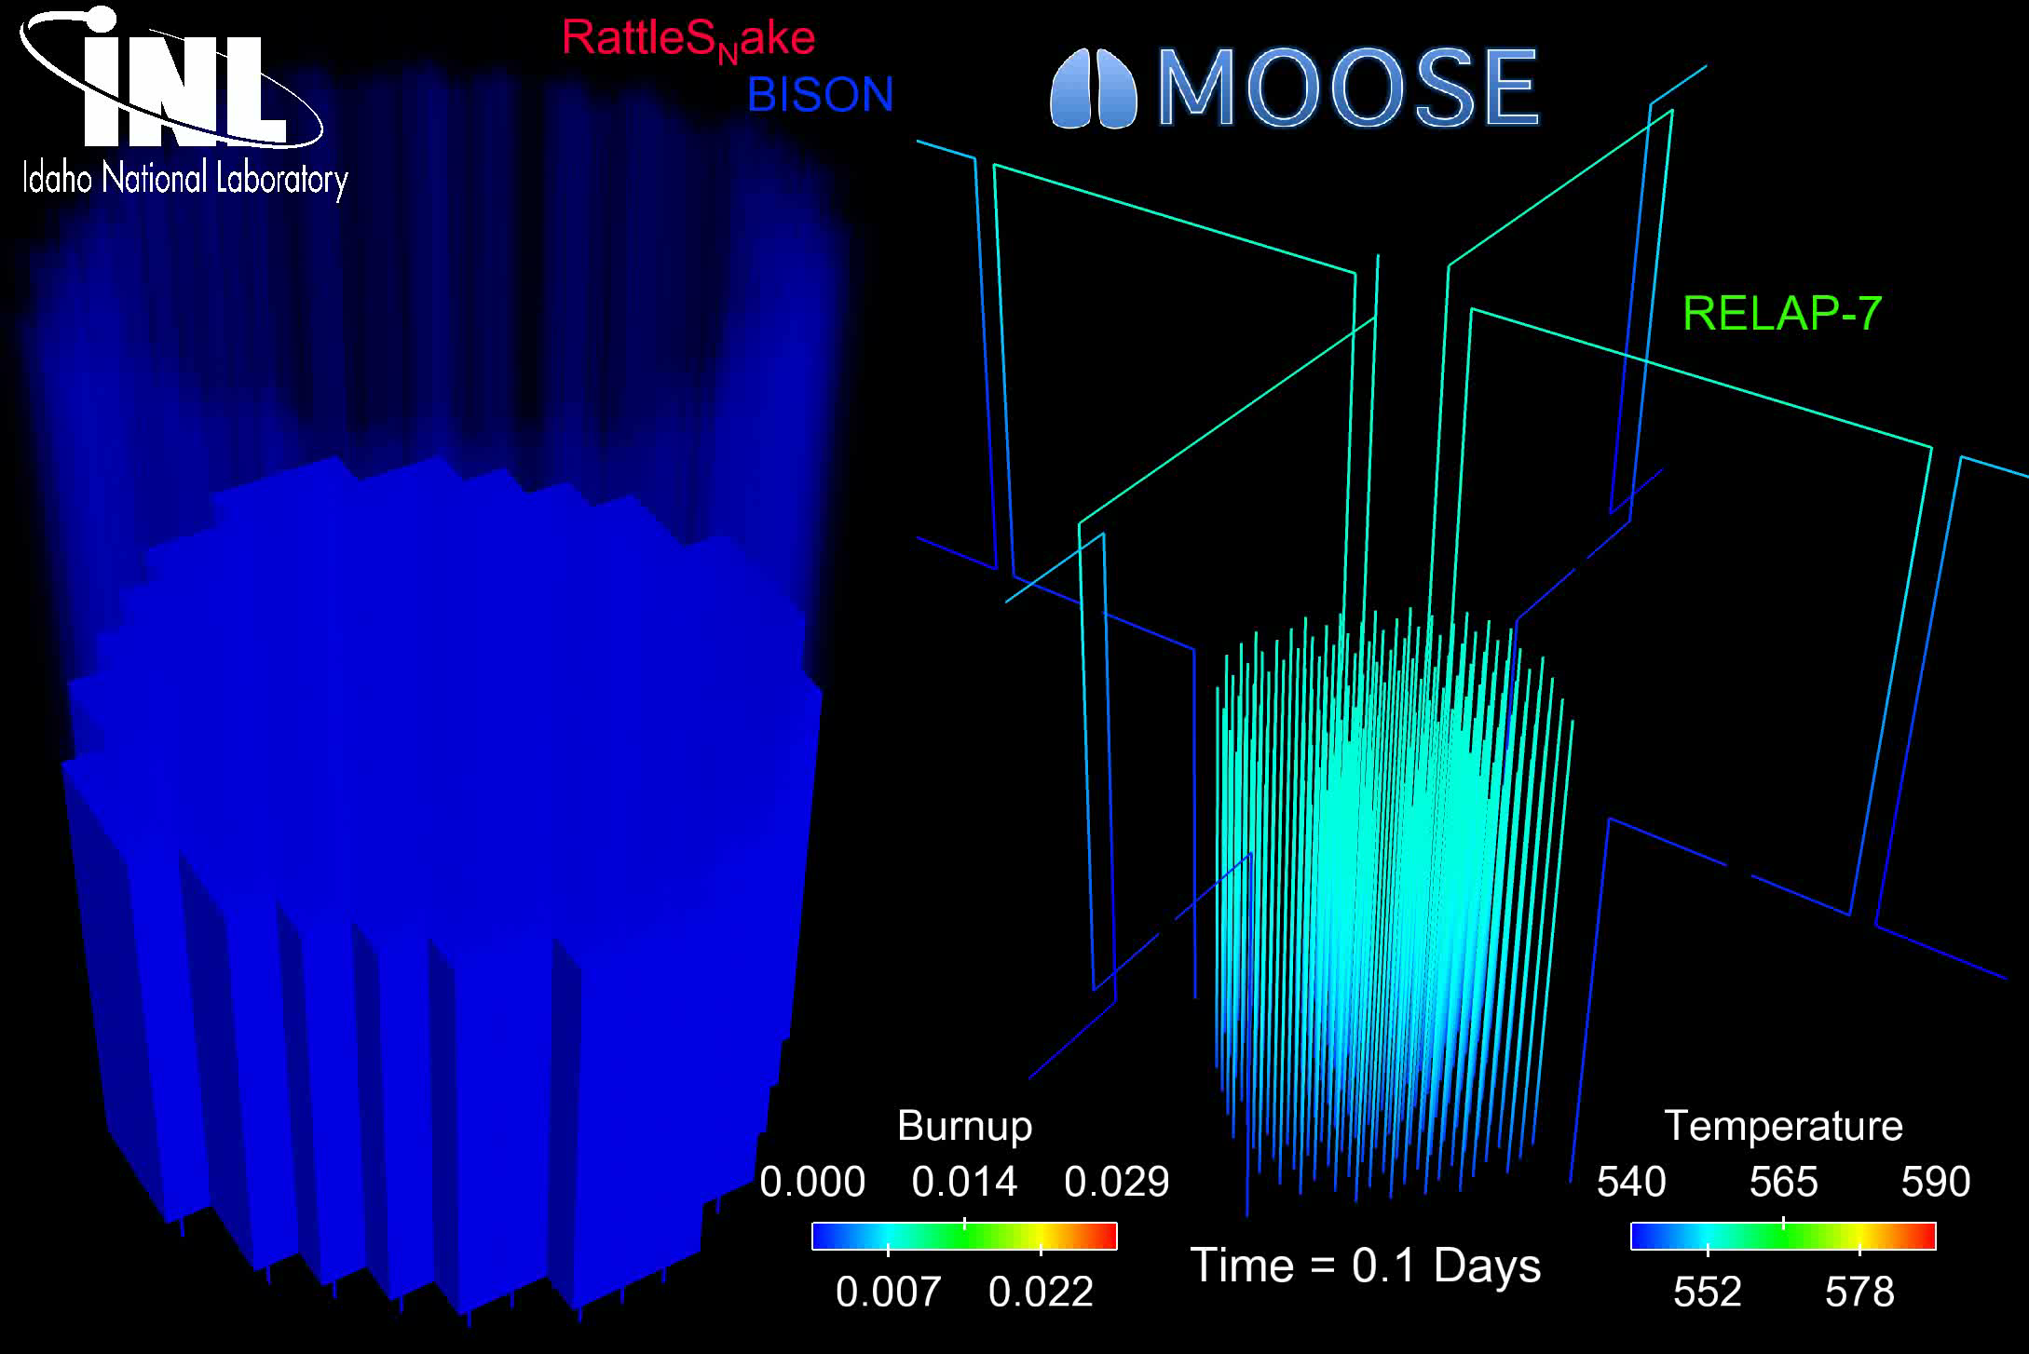
The most accurate solution is numerical, in 3D, requires modeling the entire core, and is multi-physics
Solution is 3D and changes in time
All the properties are functions of temperature
The boundary conditions comes from information about the coolant flow
The heat generation rate comes from information about the neutronics in the reactor
No analytical solution is possible

Slide 20

In order to solve, make assumptions!
#1: steady state ->
#2: cylindrical, axisymmetric ->
#3: constant in z
#4: constant thermal conductivity, volume heat

Slide 21
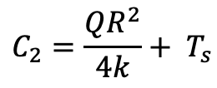
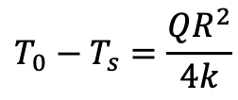
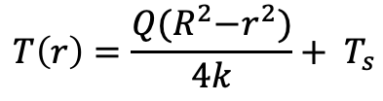
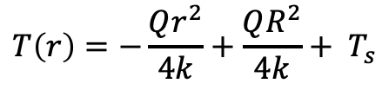
Directly Solving for Temperature Profile
Boundary conditions: r₀ = 0, r₁=R, T’(0) = 0, T(R) = T_{s}
r0
r1
$$C_{2}=\frac{QR^{2}}{4k}+ T_{s}$$
$$T\left(r\right)=−\frac{Qr^{2}}{4k}+\frac{QR^{2}}{4k}+ T_{s}$$
$$T\left(r\right)=\frac{Q{(R}^{2}−r^{2})}{4k}+ T_{s}$$
$$T_{0}−T_{s}=\frac{QR^{2}}{4k}$$

Slide 22
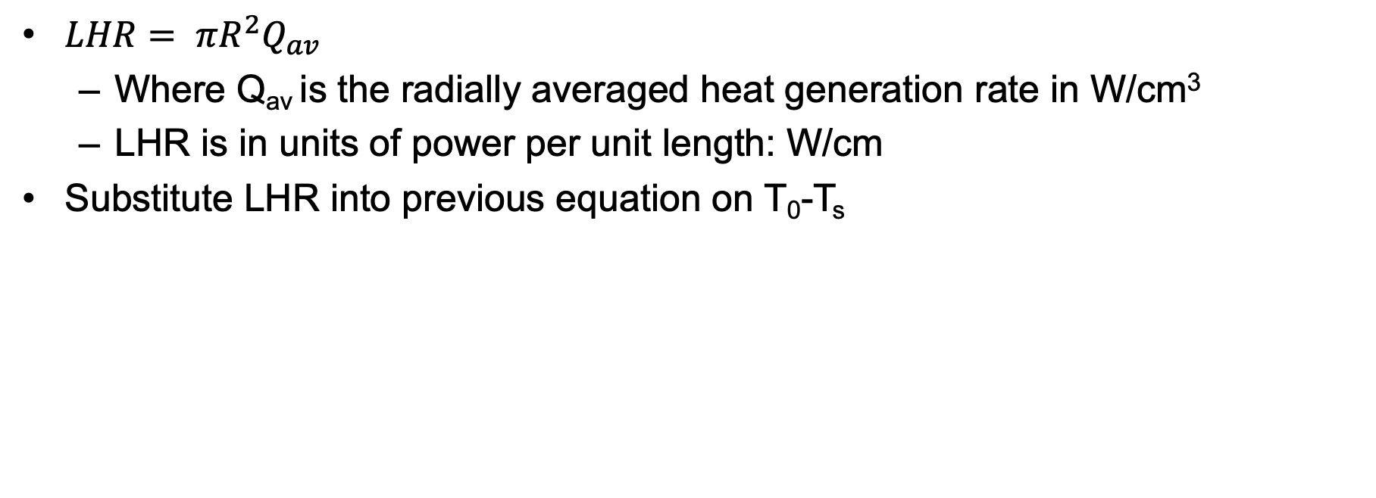
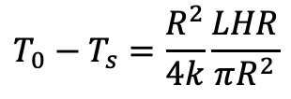
Linear Heat Rate
$LHR= πR^{2}Q_{av}$
Where Q_{av} is the radially averaged heat generation rate in W/cm³
LHR is in units of power per unit length: W/cm
Substitute LHR into previous equation on T₀-T_{s}
$$T_{0}−T_{s}=\frac{R^{2}}{4k}\frac{LHR}{πR^{2}}$$

Slide 23
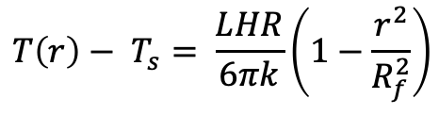
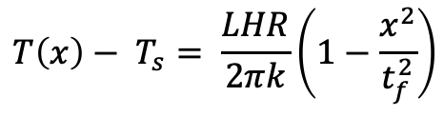
Alternate Geometries
Similar derivation with appropriate boundary conditions can be applied to plate and sphere geometries
Plate
Sphere
$$T\left(x\right)− T_{s}= \frac{LHR}{2πk}\left(1−\frac{x^{2}}{t_{f}^{2}}\right)$$
$$T\left(r\right)− T_{s}= \frac{LHR}{6πk}\left(1−\frac{r^{2}}{R_{f}^{2}}\right)$$
x is the distance from the midplane of the fuel and tf is the plate fuel thickness
r is the distance from the sphere center and Rf is the radius of the sphere

Slide 24
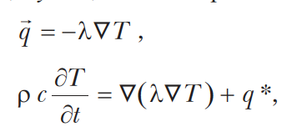
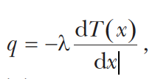
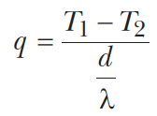
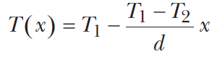
Heat transport through the gap
Heat flux is a conserved quantity, described by Fourier’s first and second laws:
If there are no sources of heat, as if the case in the cladding and gap, the temperature field is constant with time, and the heat flux is unidirectional
For boundary conditions T1 and T2 and a thickness d
This assumes a spatially constant thermal conductivity, consistent with a “thin slab”
λ = thermal cond.

Slide 25
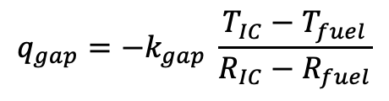
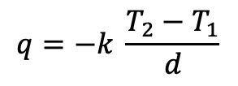
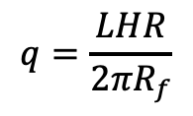
Heat transport through the gap
R₀=0
R₁=R_{f}
R₂=R_{IC}
The heat flux gives the rate, per unit area, at which heat flows in a given direction
The heat flux from the fuel is the LHR/pellet circumference
Heat flux from the fuel is the same as heat flux through the the gap – can make this assumption because R_{f} >> t_{g}
Gap thickness = R_{IC}-R_{f} = t_{g}
Cladding thickness = R_{OC}-R_{IC} = t_{c}
$$q=−k \frac{T_{2}−T_{1}}{d}$$
$$q_{gap}=−k_{gap} \frac{T_{IC}−T_{fuel}}{R_{IC}−R_{fuel}}$$
$$q=\frac{LHR}{2πR_{f}}$$
R₃=R_{OC}

Slide 26
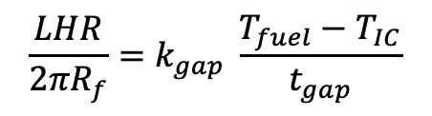
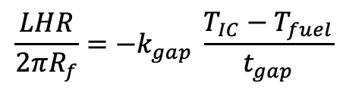
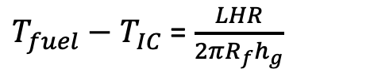
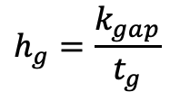
Heat transport through the gap
Set heat flux fuel/gap equal
Gap conductance is defined as:
Gap conductance depends on the gas filling the gap
For pure He, k_{gap}=16x10⁻⁶ * T^{0.79} (W/cm-K)
For pure Xe, k_{gap}=0.7x10⁻⁶ * T^{0.79} (W/cm-K)
Simple mixing rule: k_{gap} = k_{He}(1-y) + k_{Xe}y
Where y is the mole/atom fraction of Xe
$$\frac{LHR}{2πR_{f}}=−k_{gap} \frac{T_{IC}−T_{fuel}}{t_{gap}}$$
$$\frac{LHR}{2πR_{f}}=k_{gap} \frac{T_{fuel}−T_{IC}}{t_{gap}}$$
$$h_{g}=\frac{k_{gap}}{t_{g}}$$
$T_{fuel}−T_{IC}$ = $\frac{LHR}{2πR_{f}h_{g}}$

Slide 27
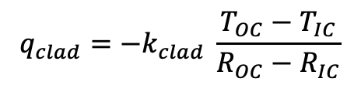
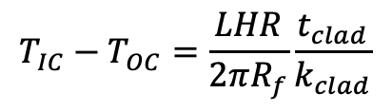
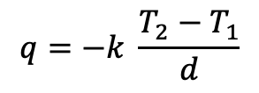
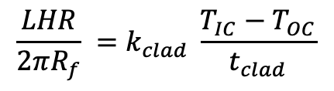
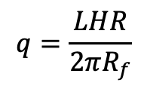
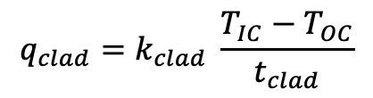
Heat transport through the cladding
$$q=−k \frac{T_{2}−T_{1}}{d}$$
$$q_{clad}=−k_{clad} \frac{T_{OC}−T_{IC}}{R_{OC}−R_{IC}}$$
Heat flux through the cladding
Set equal your heat fluxes
$$q=\frac{LHR}{2πR_{f}}$$
$$q_{clad}=k_{clad} \frac{T_{IC}−T_{OC}}{t_{clad}}$$
$$\frac{LHR}{2πR_{f}} =k_{clad} \frac{T_{IC}−T_{OC}}{t_{clad}}$$
$$T_{IC}−T_{OC}=\frac{LHR}{2πR_{f}}\frac{t_{clad}}{k_{clad}}$$

Slide 28
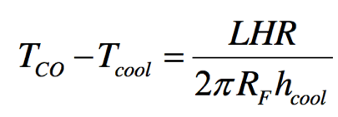
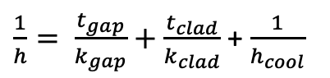
Heat transfer to the coolant
Heat is transported from the cladding to the coolant via convection
T_{cool} is the coolant temperature, h_{cool} is the convective heat transfer coefficient between cladding wall and coolant
Adding gap + cladding + coolant:
$\frac{1}{h}= \frac{t_{gap}}{k_{gap}}+$ $\frac{t_{clad}}{k_{clad}}$ + $\frac{1}{h_{cool}}$

Slide 29
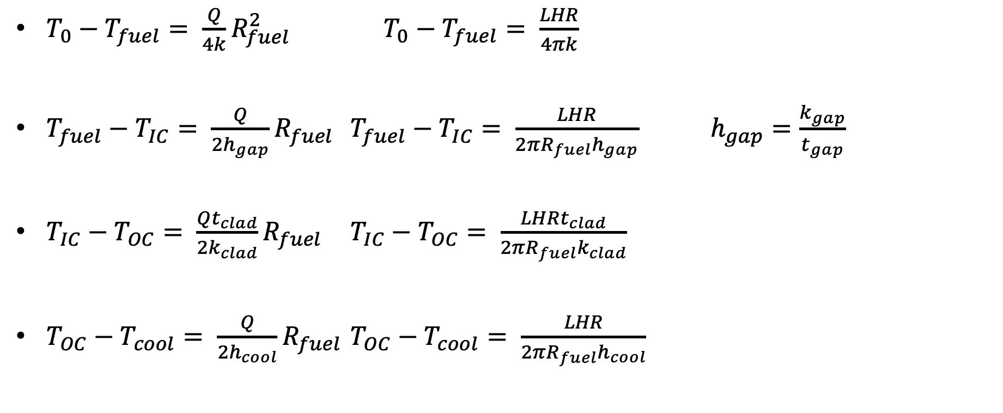
Summary of analytical solutions
$T_{0}−T_{fuel}= \frac{Q}{4k}R_{fuel}^{2}$ $T_{0}−T_{fuel}= \frac{LHR}{4πk}$
$T_{fuel}−T_{IC}= \frac{Q}{2h_{gap}}R_{fuel}$ $T_{fuel}−T_{IC}= \frac{LHR}{2{πR_{fuel}h}_{gap}}$ $h_{gap}=\frac{k_{gap}}{t_{gap}}$
$T_{IC}−T_{OC}= \frac{Qt_{clad}}{2k_{clad}}R_{fuel}$ $T_{IC}−T_{OC}= \frac{LHRt_{clad}}{2{πR_{fuel}k}_{clad}}$
$T_{OC}−T_{cool}= \frac{Q}{2h_{cool}}R_{fuel}$ $T_{OC}−T_{cool}= \frac{LHR}{2{πR_{fuel}h}_{cool}}$

Slide 30
Solving for the temperature profile
T_{CO} T_{CI}
You solve for the transition temperatures
Start from the coolant (known BC) and work inward
Have a linear profile everywhere except in the fuel
Finally, solve for the temperature profile throughout the fuel
T_{cool}

Slide 31
Fuel and Cladding Thermal Properties
Material | Density (g/cm³) | Heat Capacity Cp (J/g-K) | Thermal Conductivity k (W/cm-K) | Thermal Expansion Coefficient a (K⁻¹)
UO₂ | 10.98 | 0.33 | 0.03 | 1.2 x 10⁻⁵
Zr | 6.5 | 0.35 | 0.17 | 1.0 x 10⁻⁵
Stainless steel | 8.0 | 0.5 | 0.17 | 9.6 x 10⁻⁶

Slide 32
Example Problem

Slide 33
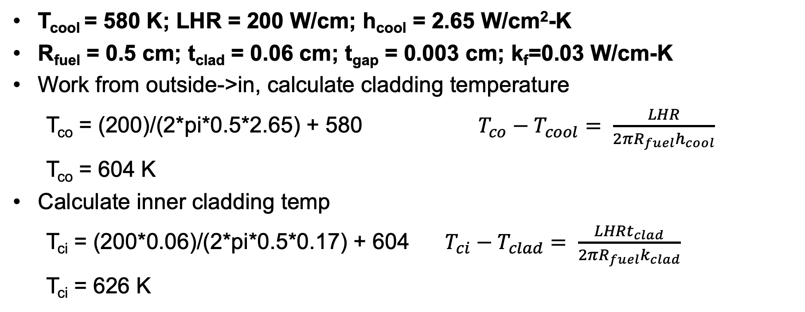
Temperature profile calculation example
T_{cool} = 580 K; LHR = 200 W/cm; h_{cool} = 2.65 W/cm²-K
R_{fuel} = 0.5 cm; t_{clad} = 0.06 cm; t_{gap} = 0.003 cm; k_{f}=0.03 W/cm-K
Work from outside->in, calculate cladding temperature
T_{co} = (200)/(2*pi*0.5*2.65) + 580 $T_{co}−T_{cool}= \frac{LHR}{2{πR_{fuel}h}_{cool}}$
T_{co} = 604 K
Calculate inner cladding temp
T_{ci} = (200*0.06)/(2*pi*0.5*0.17) + 604 $T_{ci}−T_{clad}= \frac{LHRt_{clad}}{2{πR_{fuel}k}_{clad}}$
T_{ci} = 626 K

Slide 34
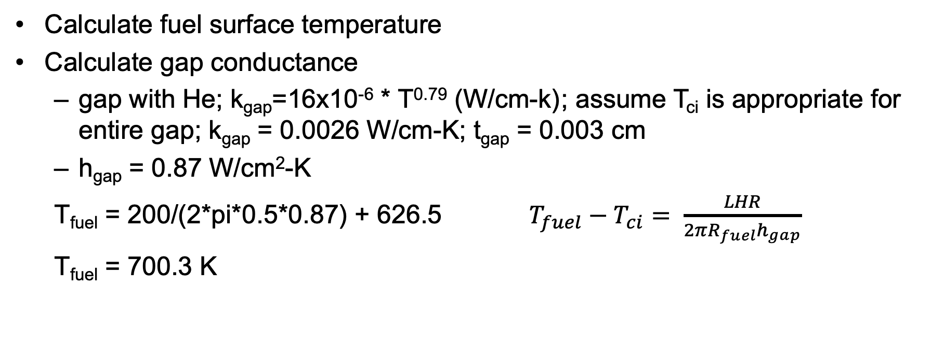
Temperature profile calculation example
Calculate fuel surface temperature
Calculate gap conductance
gap with He; k_{gap}=16x10⁻⁶ * T^{0.79} (W/cm-k) ; assume T_{ci} is appropriate for entire gap; k_{gap} = 0.0026 W/cm-K; t_{gap} = 0.003 cm
h_{gap} = 0.87 W/cm²-K
T_{fuel} = 200/(2*pi*0.5*0.87) + 626.5 $T_{fuel}−T_{ci}= \frac{LHR}{2{πR_{fuel}h}_{gap}}$
T_{fuel} = 700.3 K

Slide 35
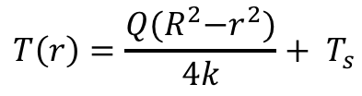
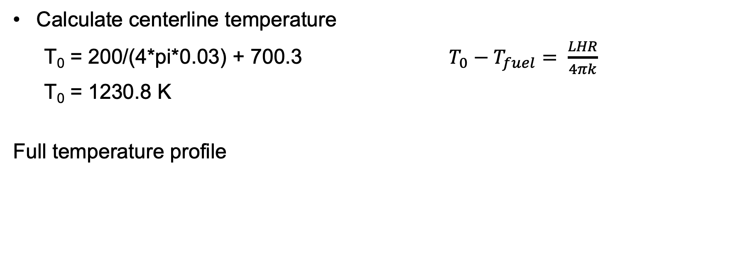
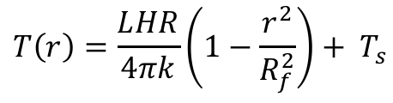
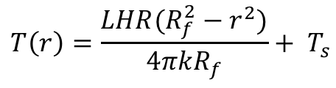
Temperature profile calculation example
Calculate centerline temperature
T₀ = 200/(4*pi*0.03) + 700.3 $T_{0}−T_{fuel}= \frac{LHR}{4πk}$
T₀ = 1230.8 K
Full temperature profile
$$T\left(r\right)=\frac{Q{(R}^{2}−r^{2})}{4k}+ T_{s}$$
$$T\left(r\right)=\frac{LHR(R_{f}^{2}−r^{2})}{4πkR_{f}}+ T_{s}$$
$$T\left(r\right)=\frac{LHR}{4πk}\left(1−\frac{r^{2}}{R_{f}^{2}}\right)+ T_{s}$$

Slide 36
Temperature profile calculation example
Parabolic temperature profile in fuel
Linear in gap and clad
Steep temperature drop over gap, very low thermal conductivity
Smaller temperature drop over cladding

Slide 37
Temperature profile modification
Instead of pure He gap, 30% of gas is Xe; how is T₀ affected?
First, how is gap conductance affected?
Gap conductance depends on the gas filling the gap
For pure He, k_{gap}=16x10⁻⁶ * T^{0.79} (W/cm-K)
For pure Xe, k_{gap}=0.7x10⁻⁶ * T^{0.79} (W/cm-K)
Simple mixing rule: k_{gap} = k_{He}(1-y) + k_{Xe}y
T_{CI}, T_{CO}, and T_{cool} is unchanged from previous example, also T₀-T_{fuel} is unchanged
k_{gap} = ((16x10⁻⁶)*(626)^{0.79} )(1-0.3) + ((0.7x10⁻⁶)*(626)^{0.79} )(0.3) = 1.85E-3 W/cm-K

Slide 38
Temperature profile modification
k_{gap} = 1.85E-3 W/cm-K
h_{gap} = 1.85E-3 / 0.003 = 0.62 W/cm²-K
T_{fuel} = 200/(2*pi*0.5*0.62) + 626 = 729 K
T₀ – T_{fuel} = 530.5 K (unchanged from before)
T₀ = 729 + 530.5 = 1259.5 K
Increase in T₀ of 30 K
Caveat: linear mixing of gases is not the best approach

Slide 39
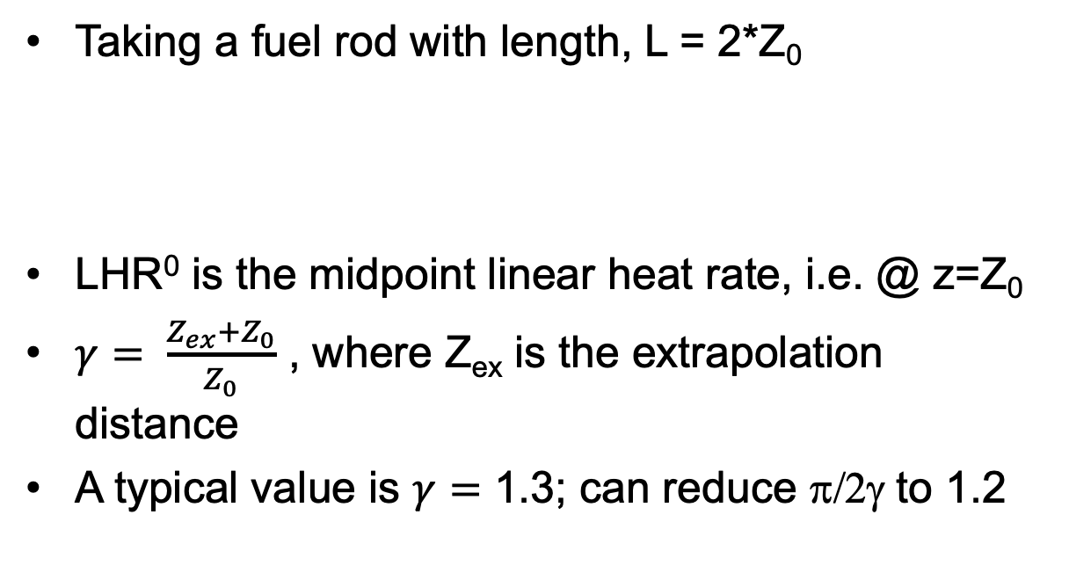
Neutron flux varies axially, so does LHR
Taking a fuel rod with length, L = 2*Z₀
LHR⁰ is the midpoint linear heat rate, i.e. @ z=Z₀
$γ= \frac{Z_{ex}+Z_{0}}{Z_{0}}$ , where Z_{ex} is the extrapolation distance
A typical value is $γ=$ 1.3; can reduce π/2γ to 1.2

Slide 40
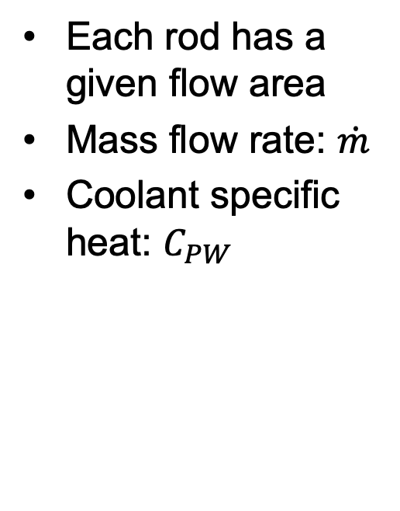
Coolant temperature varies with Z
Each rod has a given flow area
Mass flow rate: $\dot{m}$
Coolant specific heat: $C_{PW}$

Slide 41
Calculate LHR and T_{cool} with axial variation
mdot = 0.25 kg/s-rod; Z₀ = 150 cm; LHR⁰ = 150 W/cm; C_{PW} = 4200 J/kg-K; T_{in}= 570 K

Slide 42
Summary
Developed analytical expressions for the temperature profile within a fuel rod
Required to make four assumptions:
Steady-state solution
Temperature is axisymmetric
T is constant in Z
Thermal conductivity is independent of temperature
Temperature profile in the fuel is parabolic, assume linear profiles in gap, clad and coolant
Can incorporate axial variation in T_{cool} with axial variation in LHR

